Slide 1
Different Data Compression Algorithms
Rajat Minekar (31448)
Guide: Prof. P. P. Joshi

Slide 2
Index
Introduction
Motivation
Problem Statement
Scope
Literature Survey
Algorithms
Results
Conclusion

Slide 3
Introduction
Nowadays a lot of data is being produced every day because of technological evolution. Billions of people make use of internet and it’s a huge thing to handle this growing number of results.
Data are approximately 40+ zettabyte (ZB) around globally by 2020 (1ZB = 2^70 Bytes).
In 1949 , Robert Fano and Claude Shannon came up with technique to assign codewords.
Later In 1951, Prof. Huffman came up with optimal method of doing the same.

Slide 4
In principle, compression reduces the actual data size to reflect the use of fewer bits.
Lossless and lossy compression techniques are the two types of compression techniques.

Slide 5
Motivation
As we are in the digital era, our dependency on internet and electronic devices is increasing exponentially. 500 hours of video were uploaded on YouTube every minute as of may 2019, this is just a fraction of total data. Data compression needed to decrease this size to help in data storage and also in data transmission.
Data compression is a very important part of internet and it has modern techniques, views and optimizations. So, selecting proper compression algorithm is very necessary for the internet.

Slide 6
Problem Statement
To study the of Data Compression and the different techniques used to achieve it.

Slide 7
Scope
We were using the traditional compression algorithms for past years. But as we are stepping towards the future, we are dealing with emerging technologies like machine learning, data science, etc. While colluding with these technologies, we can use these technologies to make these algorithms more efficient.
We will analyze various techniques by performance measures like compression ratios. It will be possible to evaluate the effectiveness of each algorithm and analyze its optimizations using compression ratios.

Slide 8
Survey
Paper title | Authors | Conclusion
A STUDY ON VARIOUS DATA COMPRESSION TYPES AND TECHNIQUES | K.Muthuchamy | The author concluded with an overview of compression and various techniques.
Modern Lossless Compression Techniques: Review, Comparison and Analysis | Apoorv Gupta, Aman Bansal , Vidhi Khanduja | A brief comparison of compression techniques was discussed in this paper.
Research on Image Compression Coding Technology | Linglong Tan, Yong Zeng and Wenju Zhang | The impact of compression methods on images is analyzed.

Slide 9
Data Compression & Types
Data Compression is encoding data into smaller bits than it was originally.
There are two types of compression techniques.
Lossless Compression
Lossy Compression

Slide 10
Lossless Compression
The term "lossless compression" refers to data compression that reduces size without sacrificing quality.
Lossy Compression
Lossy compression is a type of compression that reduces data size while sacrificing quality.

Slide 11
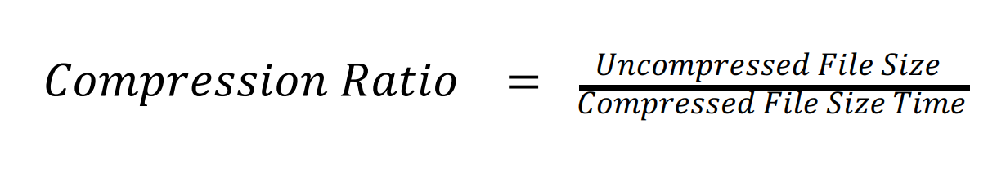
Compression Ratio
Ratio of uncompressed file size to compressed file size is called as Compression ratio.
It is the measure used to calculate performance of compression algorithm.

Slide 12
Data Compression Algorithms
Huffman Coding
Run-Length-Encoding (RLE)
Arithmetic Coding

Slide 13
Huffman Coding
Lossless compression.
Huffman Tree used for encoding.
Let’s see this with simple example.
Input = “DCODEMOI”

Slide 14
Frequency Count
Alphabet | Frequency
D | 2
C | 1
O | 2
E | 1
M | 1
I | 1

Slide 15
Create Leaf Nodes
D/2
C/1
O/2
E/1
M/1
I/1
Now Group the nodes with minimum frequency,
here C&E and M&I makes a pair.
Add This pair as children to a node combined as parent
D/2
O/2
C&E/2
C/1
M&I/2
M
E/1
I/1

Slide 16
Repeat the above step till we get a complete tree
Here Now D&O make new parent node,(C&E) & (M&I) makes new parent
D&O/4
D/2
(C&E) & (M&I)/4
C&E/2
M/1
M&I/2
I/1
O/2
C/1
E/1

Slide 17
Finally root node created as (D&O) & ( (C&E) & (M&I))
(D&O) & ((C&E) & (M&I))/8
D&O/4
(C&E) & (M&I)/4
C&E/2
M/1
M&I/2
I/1
O/2
C/1
E/1
D/2

Slide 18
Once Tree Created Assign Zeros and One to left and right child respectively
0
1
0
M
1
I
O
C
E
D
0
1
0
1
0
1
D = 00
O = 01
C = 100
M = 110
I = 111
E = 101

Slide 19
With this we can assign codes to each Alphabet
Alphabet | Code
D | 00
C | 100
O | 01
E | 101
M | 110
I | 111
DCODEMOI = 00100010010111001111
Here is Huffman code generated for Input.

Slide 20
Disadvantages
Advantages
Binary codes saves a lot of memory space.
The binary codes generated are prefix-free.
Less compression ratio than lossy methods.
Relatively slower than other.
Difficult while decoding if data is corrupt
Applications
Widely used in formats like GZIP, PKZIP (WinZip) and BZIP2.
Multimedia codes like JPEG, PNG and mp3 uses Huffman encoding

Slide 21
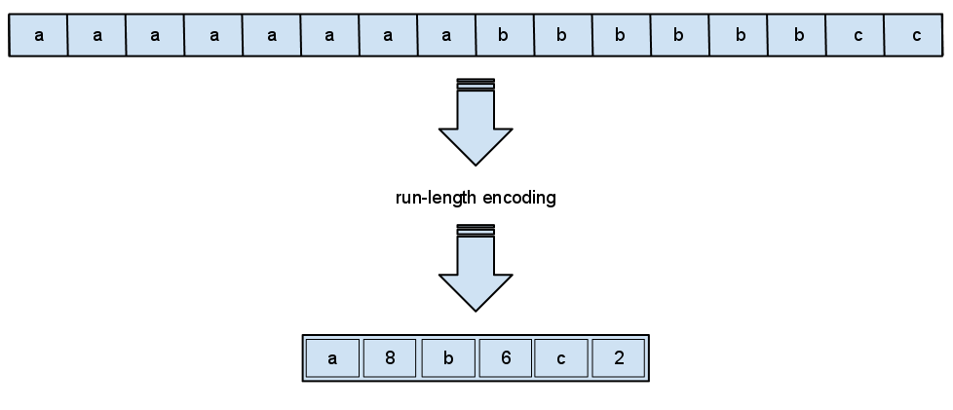
Run-Length Encoding (RLE)
Run-Length-Encoding is very easy data compression method in which data runs are stored instead of in the initial run as single data and number.

Slide 22
Algorithm
1. Take String as Input
2. In the input string count how much times an element occurs.
3. It is used to encrypt the frequency of the variable.
4. Return strings as an encoding output.

Slide 23
Disadvantages
Advantages
Easy to use and implement.
RLE compression only benefits files with a lot of redundant data.
Applications
Typically RLE is used for
1. PDF files
2. TIFF file

Slide 24
Arithmetic Encoding
Encoding depending on probabilities
Higher Compression ratio than Huffman coding
Let’s see with simple example,
Input = “ACD” , where probabilities are given as
Alphabet | Probability
A | 0.4
B | 0.3
C | 0.1
D | 0.1
E | 0.06
F | 0.04

Slide 25
We need to create Probability Ranges
Alphabet | Probability | Probability Range
A | 0.4 | 0 – 0.4
B | 0.3 | 0.4 – 0.7
C | 0.1 | 0.7 – 0.8
D | 0.1 | 0.8 – 0.9
E | 0.06 | 0.9 – 0.96
F | 0.04 | 0.96 – 1

Slide 26
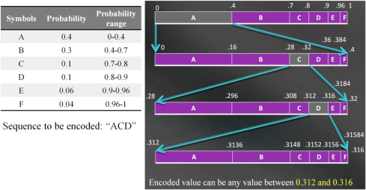
We will ”zoom” through the current interval and split it in to subintervals

Slide 27
Disadvantages
Advantages
Compression Ratio is higher than Huffman coding.
To begin symbols decoding, the whole codeword has to be obtained, and the whole message will get corrupt if a damaged bit exists inside the codeword.
Applications
Used for VLSI(Very Large Scale Integration) testing

Slide 28
Comparison
Arithmetic Coding
Huffman Coding
Run Length Encoding
Higher compression ratio than Huffman
Arithmetic Coding assigns one long code to entire input string.
Used for compression of text type of data.
Used in VSLI testing
less compression ratio than Arithmetic coding but greater than RLE.
Huffman method assign integral number of bits to each symbol.
Used for various data formats like text, image, etc.
Used for GZIP, PKZIP (WinZip) and BZIP2 and Used for Multimedia codes like JPEG, PNG and mp3
Lower compression ratio than Huffman
RLE assign codes according to frequency.
RLE used majorly for text type of data
Used for files such as pdf, tfif

Slide 29
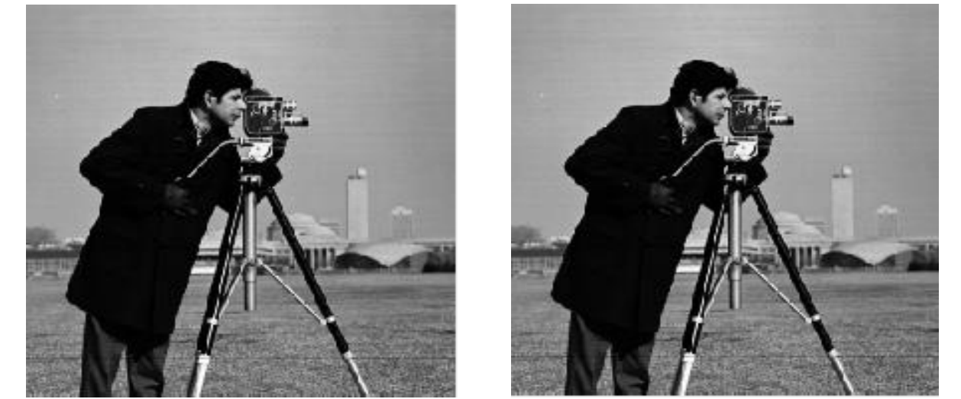
Results
Huffman Compression on Image
Compressed Image
Decompressed Image

Slide 30

Decoded Image
Run Length Coding compression on Image
Original Image
Binary Image

Slide 31
Conclusion
We have seen various Data Compression Algorithms.
Selection of Compression algorithm should depend on data format.
Huffman is standard algorithm used for general compression.
We have seen some Results of algorithms on Image file.
Here our concern was to provide a brief idea about compression and techniques to achieve.

Slide 32
Thank You !

